Slide 1
INTRACRANIAL ARTERY DISSECTION AND POSSIBLE ALTERNATIVE TREATMENT HYPOTHESIS
F. Amati¹, C. Chiapparino², G. Liaci¹, L. Pascazio¹
¹Stroke Unit, Department of Neuroscience, Policlinico Hospital, Bari, Italy
²Department of Neurology, “F. Perinei” Hospital, Altamura (BA), Italy

Slide 2
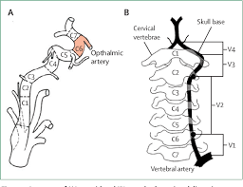
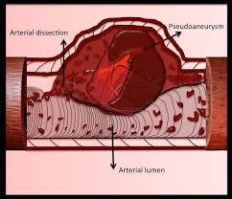
IAD
IAD is an uncommon and underdiagnosed disease AIM: to identify its pathophysiological mechanisms
and possible alternative therapies.
Methods
Eight patients (pts.), referred to the Emergency Department with focal signs, were analysed.
Work-up: neurological examination, brain CT-MRI-PW-DW/AG, Digital angiography (DA), Ultrasounds

Slide 3
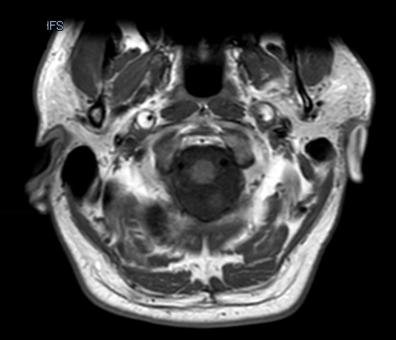
RESULTS
All pts. were diagnosed with cerebral ischaemia.
AG highlighted intradural internal carotid artery (ICA) dissection in three pts. (IAD) and both intra- and extracranial ICA dissection in one pt. (EAD and IAD)
In one subject subarachnoid haemorrhage from rupture of intradural ICA dissecting aneurysm, treated with embolization, was observed;
in another pt. dissection of the basilar artery (BA) was detected;
The other pts. were found to have vertebral artery dissection (VAD).
MRI: dissection of the extracranial portion of both ICAs.

Slide 4
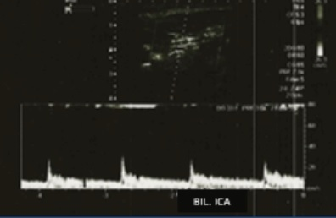
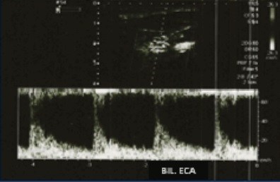
ULTRASOUND
Ultrasound monitoring, given in all pts. during Stroke Unit hospitalisation, detected intradural ICA occlusion in two subjects.
A pt. with fibrodysplasia showed a typical finding of both intra- extracranial bilateral ICA dissection and vicarious external carotid arteries plus intracranial anterior and posterior compensation.
Ultimately VA occlusion in two pts. and post-recanalization stenosis in three cases were observed.

Slide 5
RIGHT ACA
BIL. MCA
LEFT PCA
BA

Slide 6
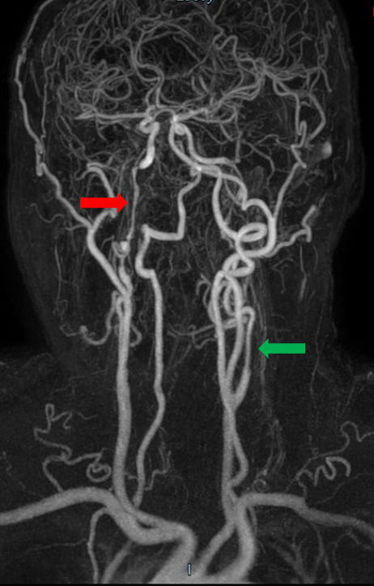
TREATMENT
Four pts. were given alteplase, followed by mechanical thrombectomy (MT) in two subjects; one pt. underwent only BA MT.
The thrombolytic was administered in all pts. with confirmed diagnosis of vessel occlusion prior to the dissection finding.
Subsequent or alternative therapy was aspirin.
The three-month outcome (mRS) was good in all patients.
MRA: dissections of the intracranial part of the right ICA (red arrow) and the extracranial part of the left ICA (green arrow).

Slide 7
CONCLUSIONS
The thrombolytic therapy did not cause bleeding in the small sample of examined pts., thus suggesting that it acts on the thrombotic process without affecting the integrity of the vessel wall, although the latter is poorly equipped with elastic fibres and easily vulnerable to any noxa (probably more traumatic than pharmacological).
The study of these few cases highlights the role of ultrasound in confirming dissection diagnosis and provides ideas to reflect on alternative treatments that could envisage, after specific trials, the use of thrombolysis also in intracranial vessels dissections.
Meta-analysis and observational studies suggest alternative treatment as IV-TL also in intracranial artery dissection if neither SAH nor other standard contraindications occur.
( No randomized trials, no specific studies on IAD )

